Slide 1
Lesson 9 – Homework review

Slide 2
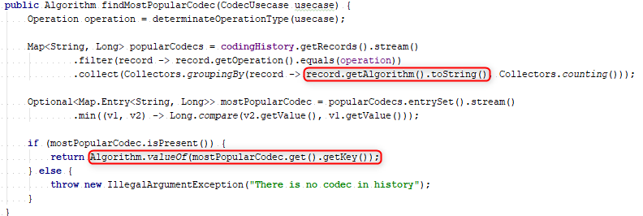
Avoid useless convertings

Slide 3
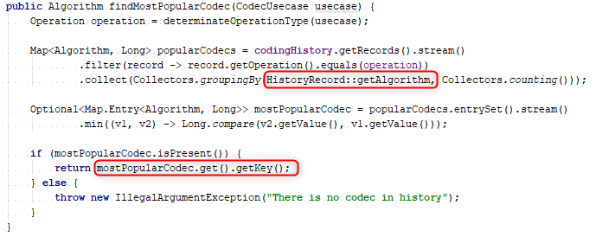
Avoid useless convertings

Slide 4
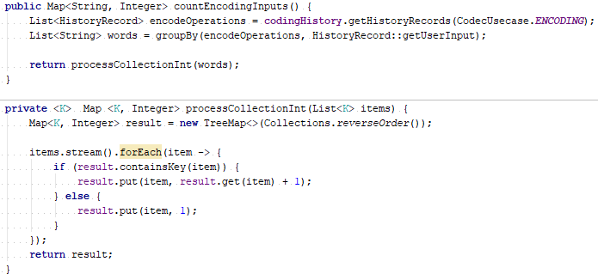
Use features provided by API

Slide 5
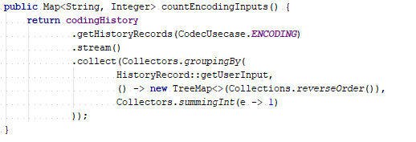
Use features provided by API

Slide 6

Do not change method signature

Slide 7

Do not change method signature

Slide 8

Use correct methods names and methods

Slide 9

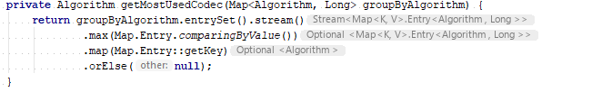
Do not call Optional#get without verification

Slide 10
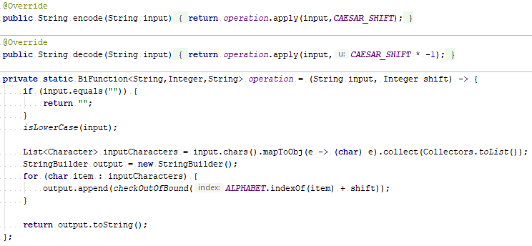
Do not use lambdas everywhere

Slide 11
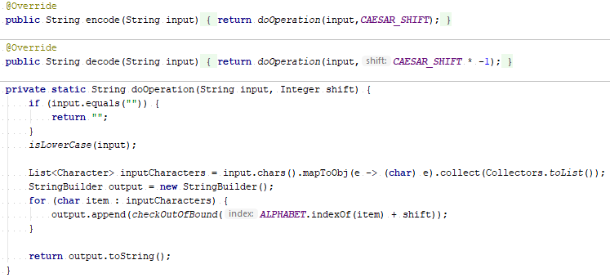
Do not use lambdas everywhere

Slide 12
Links
Stream API

Slide 13
Apply recommendations from personal feedbacks before starting next homework

